Slide 1
Software Product Metrics
Software quality
A framework for product metrics
A product metrics taxonomy
Metrics for the analysis model
Metrics for the design model
Metrics for maintenance
(Source: Pressman, R. Software Engineering: A Practitioner’s Approach. McGraw-Hill, 2005)

Slide 2
Examples of Metrics from Everyday Life
Working and living
  Cost of utilities for the month
  Cost of groceries for the month
  Amount of monthly rent per month
  Time spent at work each Saturday for the past month
  Time spent mowing the lawn for the past two times
College experience
  Grades received in class last semester
  Number of classes taken each semester
  Amount of time spent in class this week
  Amount of time spent on studying and homework this week
  Number of hours of sleep last night
Travel
  Time to drive from home to the airport
  Amount of miles traveled today
  Cost of meals and lodging for yesterday

Slide 3
Why have Software Product Metrics?
Help software engineers to better understand the attributes of models and assess the quality of the software
Help software engineers to gain insight into the design and construction of the software
Focus on specific attributes of software engineering work products resulting from analysis, design, coding, and testing
Provide a systematic way to assess quality based on a set of clearly defined rules
Provide an “on-the-spot” rather than “after-the-fact” insight into the software development

Slide 4
Software Quality

Slide 5
Software Quality Defined
Definition:
Conformance to explicitly stated functional and performance requirements, explicitly documented development standards, and implicit characteristics that are expected of all professionally developed software
Three important points in this definition
  Explicit software requirements are the foundation from which quality is measured. Lack of conformance to requirements is lack of quality
  Specific standards define a set of development criteria that guide the manner in which software is engineered. If the criteria are not followed, lack of quality will most surely result
  There is a set of implicit requirements that often goes unmentioned (e.g., ease of use). If software conforms to its explicit requirements but fails to meet implicit requirements, software quality is suspect

Slide 6
Properties of Software Quality Factors
Some factors can be directly measured (e.g. defects uncovered during testing)
Other factors can be measured only indirectly (e.g., usability or maintainability)
Software quality factors can focus on three important aspects
  Product operation: Its operational characteristics
  Product revision: Its ability to undergo change
  Product transition: Its adaptability to new environments

Slide 7
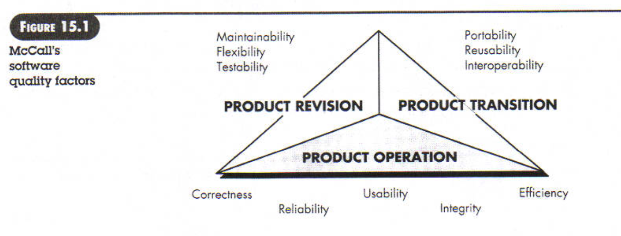

Slide 8
ISO 9126 Software Quality Factors
Functionality
  The degree to which the software satisfies stated needs of sub attributes.
Reliability
  The amount of time that the software is available for use.
Usability
  The degree to which the software is easy to use.
Efficiency
  The degree to which the software makes optimal use of system resources
Maintainability
  The ease with which repair and enhancement may be made to the software
Portability
  The ease with which the software can be transposed from one environment to another

Slide 9
A Framework for
Product Metrics

Slide 10
Measures, Metrics, and Indicators
These three terms are often used interchangeably, but they can have subtle differences
Measure
  Provides a quantitative indication of the extent, amount, dimension, capacity, or size of some attribute of a product or process
Measurement
  The act of determining a measure
Metric
  (IEEE) A quantitative measure of the degree to which a system, component, or process possesses a given attribute
Indicator
  A metric or combination of metrics that provides insight into the software process, a software project, or the product itself

Slide 11
Purpose of Product Metrics
Aid in the evaluation of analysis and design models
Provide an indication of the complexity of procedural designs and source code
Facilitate the design of more effective testing techniques
Assess the stability of a fielded software product

Slide 12
Activities of a Measurement Process
Formulation
  The derivation (i.e., identification) of software measures and metrics appropriate for the representation of the software that is being considered
Collection
  The mechanism used to accumulate data required to derive the formulated metrics
Analysis
  The computation of metrics and the application of mathematical tools
Interpretation
  The evaluation of metrics in an effort to gain insight into the quality of the representation
Feedback
  Recommendations derived from the interpretation of product metrics and passed on to the software development team

Slide 13
Characterizing and Validating Metrics
A metric should have desirable mathematical properties
  It should have a meaningful range (e.g., zero to ten)
  It should not be set on a rational scale if it is composed of components measured on an ordinal scale
If a metric represents a software characteristic that increases when positive traits occur or decreases when undesirable traits are encountered, the value of the metric should increase or decrease in the same manner
Each metric should be validated empirically in a wide variety of contexts before being published or used to make decisions
  It should measure the factor of interest independently of other factors
  It should scale up to large systems
  It should work in a variety of programming languages and system domains

Slide 14
Collection and Analysis Guidelines
Whenever possible, data collection and analysis should be automated
Valid statistical techniques should be applied to establish relationships between internal product attributes and external quality characteristics
Interpretative guidelines and recommendations should be established for each metric

Slide 15
Goal-oriented Software Measurement
Goal/Question/Metric (GQM) paradigm
GQM technique identifies meaningful metrics for any part of the software process
GQM emphasizes the need to
  Establish an explicit measurement goal that is specific to the process activity or product characteristic that is to be assessed
  Define a set of questions that must be answered in order to achieve the goal
  Identify well-formulated metrics that help to answer these questions
GQM utilizes a goal definition template to define each measurement goal
(More on next slide)

Slide 16
Goal-oriented Software Measurement (continued)
Example use of goal definition template
Analyze the SafeHome software architecture for the purpose of evaluating architecture components. Do this with respect to the ability to make SafeHome more extensible from the viewpoint of the software engineers, who are performing the work in the context of product enhancement over the next three years.
Example questions for this goal definition
  Are architectural components characterized in a manner that compartmentalizes function and related data?
  Is the complexity of each component within bounds that will facilitate modification and extension?

Slide 17
Attributes of Effective Software Metrics
Simple and computable
  It should be relatively easy to learn how to derive the metric, and its computation should not demand inordinate effort or time
Empirically and intuitively persuasive
  The metric should satisfy the engineer’s intuitive notions about the product attribute under consideration
Consistent and objective
  The metric should always yield results that are unambiguous
(More on next slide)

Slide 18
Attributes of Effective Software Metrics (continued)
Consistent in the use of units and dimensions
  The mathematical computation of the metric should use measures that do not lead to bizarre combinations of units
Programming language independent
  Metrics should be based on the analysis model, the design model, or the structure of the program itself
An effective mechanism for high-quality feedback
  The metric should lead to a higher-quality end product

Slide 19
A Product Metrics Taxonomy

Slide 20
Metrics for the Analysis Model
Functionality delivered
  Provides an indirect measure of the functionality that is packaged within the software
System size
  Measures the overall size of the system defined in terms of information available as part of the analysis model
Specification quality
  Provides an indication of the specificity and completeness of a requirements specification

Slide 21
Metrics for the Design Model
Architectural metrics
  Provide an indication of the quality of the architectural design
Component-level metrics
  Measure the complexity of software components and other characteristics that have a bearing on quality
Interface design metrics
  Focus primarily on usability
Specialized object-oriented design metrics
  Measure characteristics of classes and their communication and collaboration characteristics

Slide 22
Metrics for Source Code
Halstead metrics
  It provides unique measures of a computer program.
Complexity metrics
  Measure the logical complexity of source code (can also be applied to component-level design)
Length metrics
  Provide an indication of the size of the software
“These metrics can be used to assess source code complexity,
maintainability, and testability, among other characteristics”

Slide 23
Metrics for Testing
Statement and branch coverage metrics
  Lead to the design of test cases that provide program coverage
Defect-related metrics
  Focus on defects (i.e., bugs) found, rather than on the tests themselves
Testing effectiveness metrics
  Provide a real-time indication of the effectiveness of tests that have been conducted
In-process metrics
  Process related metrics that can be determined as testing is conducted

Slide 24
Metrics for the
Analysis Model
Function Points

Slide 25
Introduction to Function Points
First proposed by Albrecht in 1979; hundreds of books and papers have been written on functions points since then
Can be used effectively as a means for measuring the functionality delivered by a system
Using historical data, function points can be used to
  Estimate the cost or effort required to design, code, and test the software
  Predict the number of errors that will be encountered during testing
  Forecast the number of components and/or the number of projected source code lines in the implemented system
Derived using an empirical relationship based on
  Countable (direct) measures of the software’s information domain
  Assessments of the software’s complexity

Slide 26
Information Domain Values
Number of external inputs(EIs)
  Each external input originates from a user or is transmitted from another application
  They provide distinct application-oriented data or control information
  They are often used to update internal logical files
  They are not inquiries (those are counted under another category)
Number of external outputs(Eos)
  Each external output is derived within the application and provides information to the user
  This refers to reports, screens, error messages, etc.
  Individual data items within a report or screen are not counted separately
(More on next slide)

Slide 27
Information Domain Values (continued)
Number of external inquiries(EQs)
  An external inquiry is defined as an online input that results in the generation of some immediate software response
  The response is in the form of an on-line output
Number of internal logical files(ILFs)
  Each internal logical file is a logical grouping of data that resides within the application’s boundary and is maintained via external inputs
Number of external interface files(EIFs)
  Each external interface file is a logical grouping of data that resides external to the application but provides data that may be of use to the application

Slide 28
Function Point Computation
Identify/collect the information domain values
Complete the table shown below to get the count total
  Associate a weighting factor (i.e., complexity value) with each count based on criteria established by the software development organization
Evaluate and sum up the adjustment factors (see the next two slides)
  “F_{i}” refers to 14 value adjustment factors, with each ranging in value from 0 (not important) to 5 (absolutely essential)
Compute the number of function points (FP)
FP = count total * [0.65 + 0.01 * sum(F_{i})]

Slide 29
Information Weighting Factor
Domain Value Count Simple Average Complex
External Inputs _____ x 3 4 6 = _____
External Outputs _____ x 4 5 7 = _____
External Inquiries _____ x 3 4 6 = _____
Internal Logical Files _____ x 7 10 15 = _____
External Interface Files _____ x 5 7 10 = _____
Count total ________

Slide 30
Value Adjustment Factors
Does the system require reliable backup and recovery?
Are specialized data communications required to transfer information to or from the application?
Are there distributed processing functions?
Is performance critical?
Will the system run in an existing, heavily utilized operational environment?
Does the system require on-line data entry?
Does the on-line data entry require the input transaction to be built over multiple screens or operations?
(More on next slide)

Slide 31
Value Adjustment Factors (continued)
Are the internal logical files updated on-line?
Are the inputs, outputs, files, or inquiries complex?
Is the internal processing complex?
Is the code designed to be reusable?
Are conversion and installation included in the design?
Is the system designed for multiple installations in different organizations?
Is the application designed to facilitate change and for ease of use by the user?

Slide 32
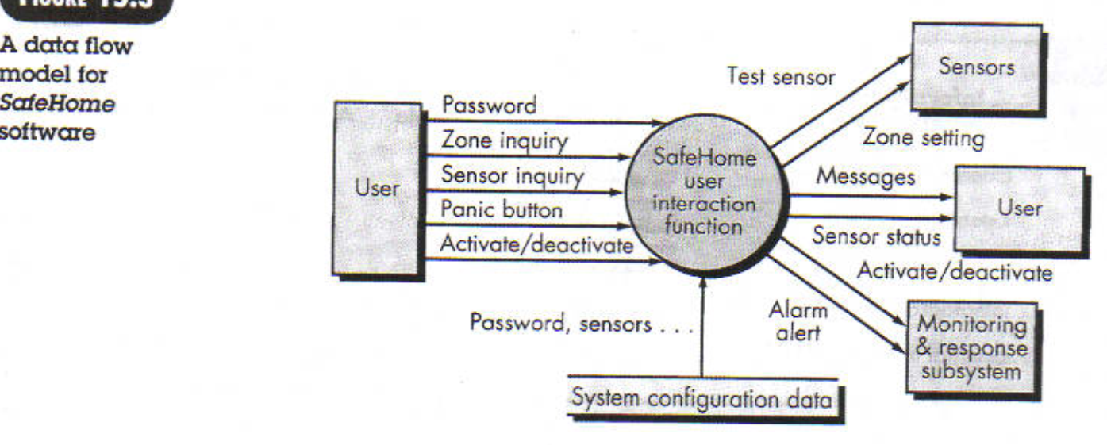
Example:

Slide 33
Function Point Example
Information Weighting Factor
Domain Value Count Simple Average Complex
External Inputs 3 x 3 4 6 = 9
External Outputs 2 x 4 5 7 = 8
External Inquiries 2 x 3 4 6 = 6
Internal Logical Files 1 x 7 10 15 = 7
External Interface Files 4 x 5 7 10 = 20
Count total 50
FP = count total * [0.65 + 0.01 * sum(F_{i})]
FP = 50 * [0.65 + (0.01 * 46)]
FP = 55.5 (rounded up to 56)

Slide 34
Interpretation of the FP Number
Assume that past project data for a software development group indicates that
  One FP translates into 60 lines of object-oriented source code
  12 FPs are produced for each person-month of effort
  An average of three errors per function point are found during analysis and design reviews
  An average of four errors per function point are found during unit and integration testing
This data can help project managers revise their earlier estimates
This data can also help software engineers estimate the overall implementation size of their code and assess the completeness of their review and testing activities

Slide 35

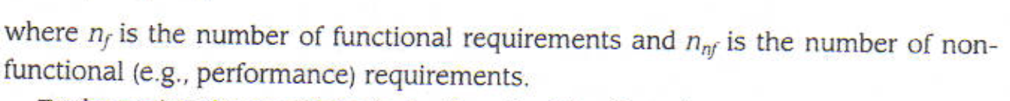

Metrics for specification Quality
Davis proposed a list of characteristics that can be used to assess the quality of the analysis model and corresponding requirement specifications.
correctness, completeness, understandability, specificity, internal and external consistency, achievability …etc.
where

Slide 36
Metrics for the
Design Model

Slide 37
Architectural Design Metrics
These metrics place emphasis on the architectural structure and effectiveness of modules or components within the architecture
They are “black box” in that they do not require any knowledge of the inner workings of a particular software component

Slide 38
Hierarchical Architecture Metrics
Fan out: the number of modules immediately subordinate to the module i, that is, the number of modules directly invoked by module i
Structural complexity
  S(i) = f²_{out}(i), where f_{out}(i) is the “fan out” of module i
Data complexity
  D(i) = v(i)/[f_{out}(i) + 1], where v(i) is the number of input and output variables that are passed to and from module i
System complexity
  C(i) = S(i) + D(i)
As each of these complexity values increases, the overall architectural complexity of the system also increases
This leads to greater likelihood that the integration and testing effort will also increase

Slide 39
Hierarchical Architecture Metrics (continued)
Shape complexity
  size = n + a, where n is the number of nodes and a is the number of arcs
  Allows different program software architectures to be compared in a straightforward manner
Connectivity density (i.e., the arc-to-node ratio)
  r = a/n
  May provide a simple indication of the coupling in the software architecture

Slide 40
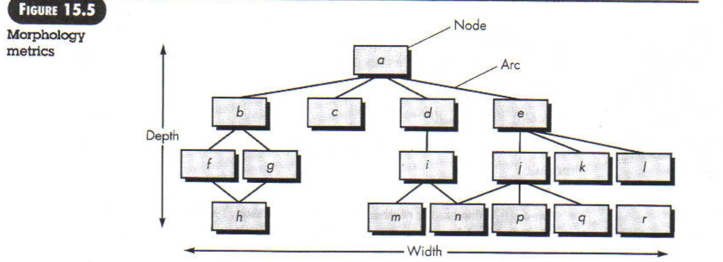
Example:

Slide 41
Metrics for Object-Oriented Design
Size
  Population: a static count of all classes and methods
  Volume: a dynamic count of all instantiated objects at a given time
  Length: the depth of an inheritance tree
Coupling
  The number of collaborations between classes or the number of methods called between objects
Cohesion
  The cohesion of a class is the degree to which its set of properties is part of the problem or design domain
Primitiveness
  The degree to which a method in a class is atomic (i.e., the method cannot be constructed out of a sequence of other methods provided by the class)

Slide 42
Specific Class-oriented Metrics
Weighted methods per class(WMC)
  The normalized complexity of the methods in a class
  Indicates the amount of effort to implement and test a class
Depth of the inheritance tree(DIT)
  The maximum length from the derived class (the node) to the base class (the root)
  Indicates the potential difficulties when attempting to predict the behavior of a class because of the number of inherited methods
Number of children (i.e., subclasses)(NOC)
  As the number of children of a class grows
    Reuse increases
    The abstraction represented by the parent class can be diluted by inappropriate children
    The amount of testing required will increase
(More on next slide)

Slide 43
Specific Class-oriented Metrics (continued)
Coupling between object classes(CBO)
  Measures the number of collaborations a class has with any other classes
  Higher coupling decreases the reusability of a class
  Higher coupling complicates modifications and testing
  Coupling should be kept as low as possible
Response for a class(RFC)
  This is the set of methods that can potentially be executed in a class in response to a public method call from outside the class
  As the response value increases, the effort required for testing also increases as does the overall design complexity of the class
Lack of cohesion in methods(LCOM)
  This measures the number of methods that access one or more of the same instance variables (i.e., attributes) of a class
  If no methods access the same attribute, then the measure is zero
  As the measure increases, methods become more coupled to one another via attributes, thereby increasing the complexity of the class design

Slide 44
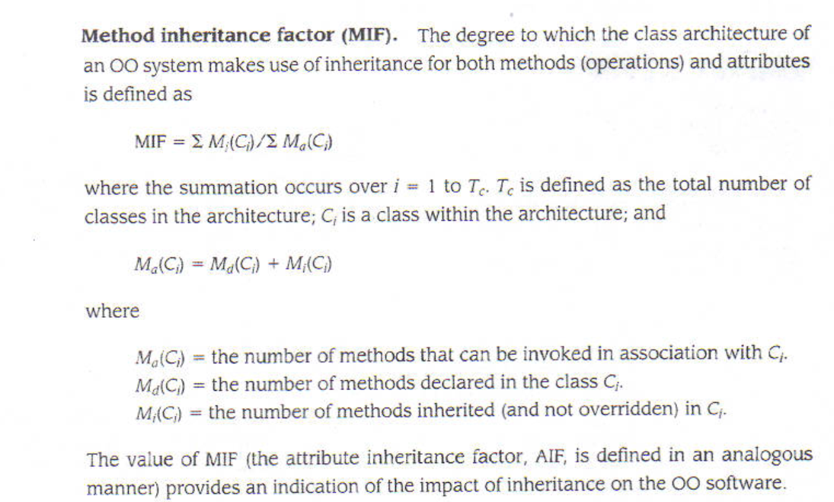

Slide 45
Metrics for Maintenance

Slide 46
Metrics for Maintenance
Software maturity index (SMI)
  Provides an indication of the stability of a software product based on changes that occur for each release
SMI = [M_{T} - (F_{a} + F_{c} + F_{d})]/M_{T}
where
M_{T} = #modules in the current release
F_{a} = #modules in the current release that have been added
F_{c} = #modules in the current release that have been changed
F_{d} = #modules from the preceding release that were deleted in the current release
As the SMI (i.e., the fraction) approaches 1.0, the software product begins to stabilize
The average time to produce a release of a software product can be correlated with the SMI
☺

